Slide 1


SAP UI5 & FIORI with OData TRAINING
Anubhav Oberoy
Day – 12

Slide 2

Agenda – Day 12
Important Tcodes in SAP Logon
Structure of Data Model for our use case
Creating Odata Service.
Steps by Step Process to Create Odata service.
Introduction to Runtime Artifacts
Implementing Get Entity and EntitySet Methods.
Introduction ot Postman Tool.

Slide 3
TCodes and Service
SEGW – SAP Service Gateway Builder
/n/IWFND/MAINT_SERVICE – Register the service
/n/IWFND/GW_CLIENT – gateway client – test locally
/n/IWFND/ERROR_LOG – Check errors, troubleshoot
EPM – Enterprise procurement model – Demo data model given by SAP for Training and demonstration.
ITeIO
SO
Customers
PO
Suppliers
Invoices
Stock

Slide 4
Data Model for our use case
EPM Data model = Enterprise Procurement Model
This is a sample data model for learning and education purpose since it is a demo model, we are not risking any productive objects in our system. The data model has
All the BAPI starts with BAPI_EPM*
Products (SNWD_PD, SNWD_TEXTS)
BAPI_EPM_PRODUCT_GET_LIST – All the list of products
BAPI_EPM_PRODUCT_GET_DETAILS – Read single product by key
BAPI_EPM_PRODUCT_CREATE – Create new product
BAPI_EPM_PRODUCT_DELETE – Delete product
BAPI_EPM_PRODUCT_UPDATE – Change data of a product
Business Partners (SNWD_BPA)
BAPI_EPM_BP_GET_LIST – All the list of Business Partners
BAPI_EPM_ BP_GET_DETAILS – Read single Business Partners by key
BAPI_EPM_ BP_CREATE – Create new Business Partners
BAPI_EPM_ BP_DELETE – Delete Business Partners
BAPI_EPM_ BP_UPDATE – Change data of a Business Partners
Orders (SNWD_SO, SNWD_SO_I)

Slide 5
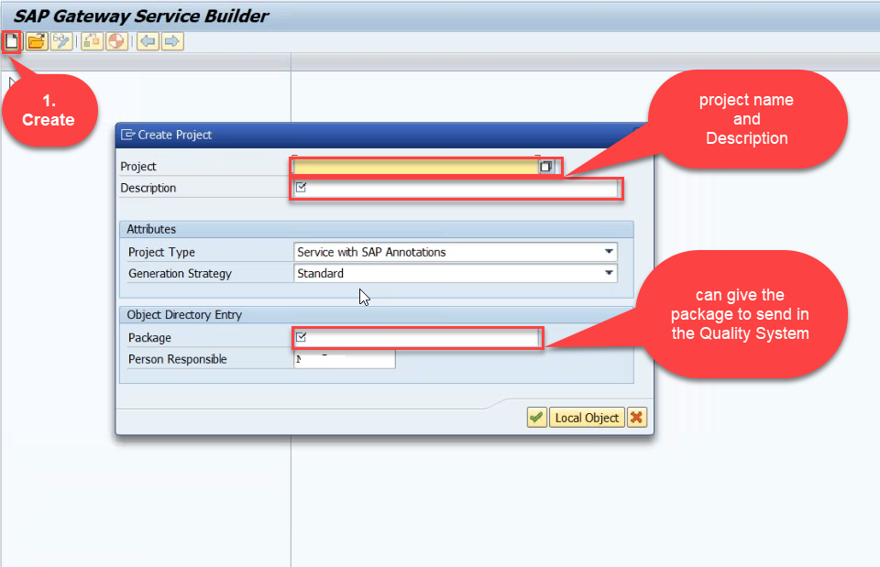
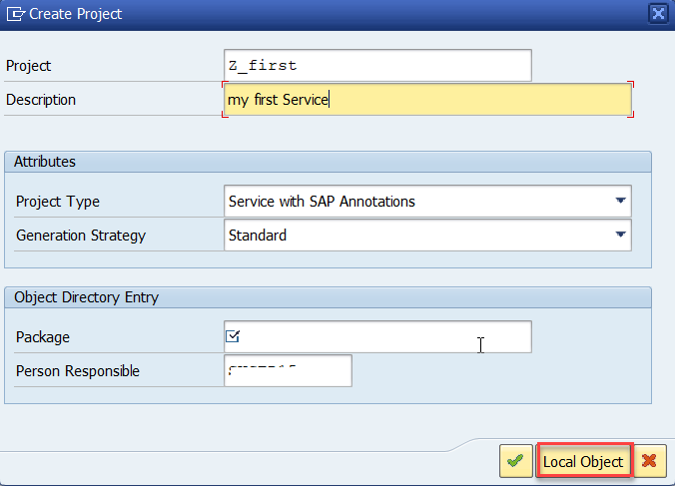
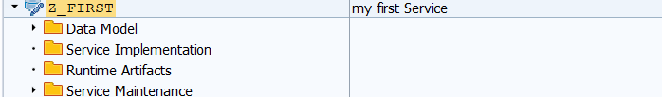
Creating OData Service
Step1: Start your SAP LOGON, and to Sap Gateway Service Builder(SEGW) and click on Create

Slide 6
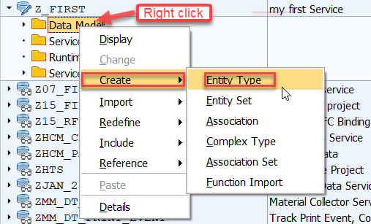
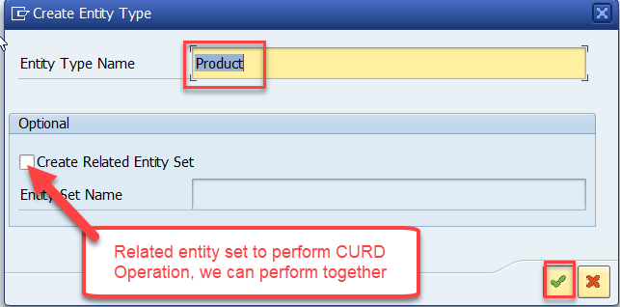
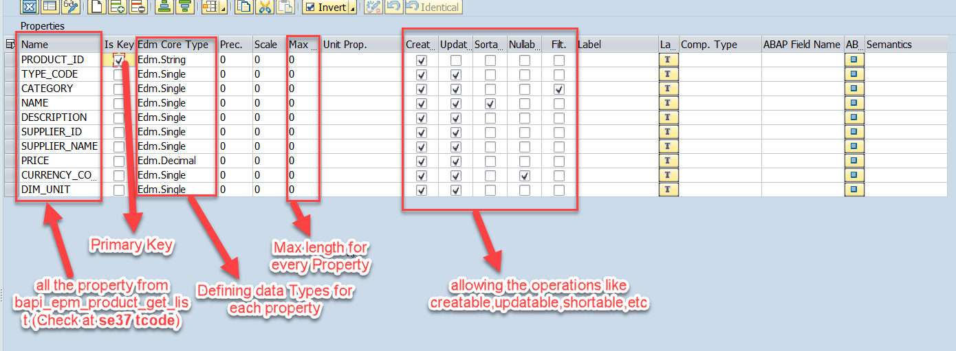
Creating OData Service Continue…
Step2: Defining the Data Model (Blueprint of data)
Step3: Creating Properties for data model (from bapi_epm_product_get_list (TCode- se37))

Slide 7
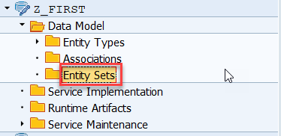
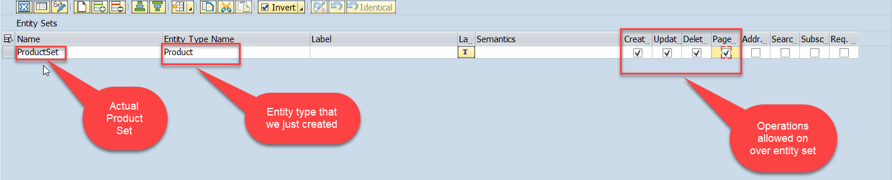
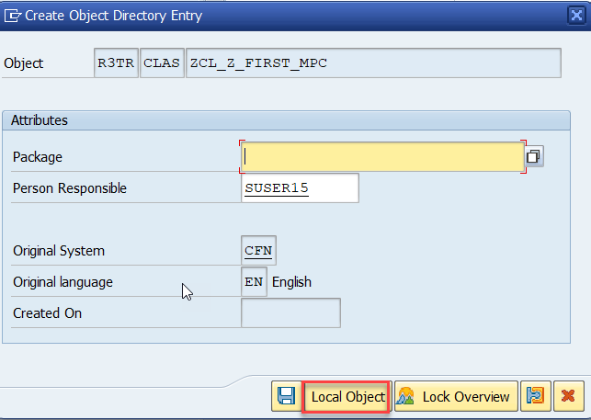
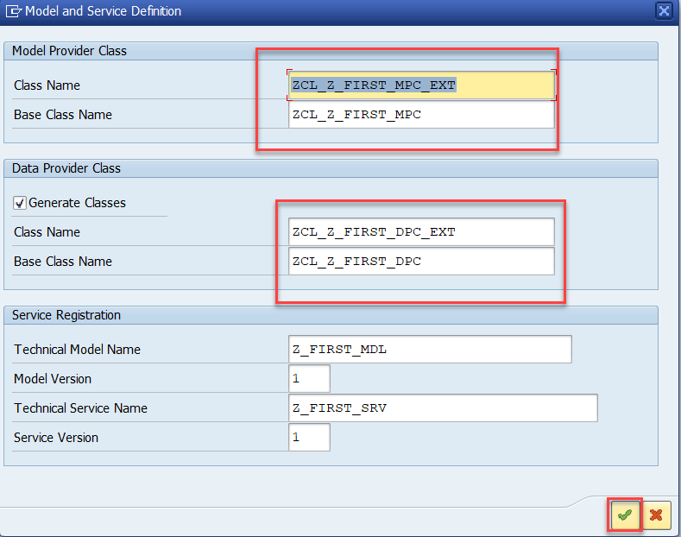
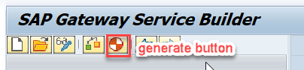
Creating OData Service Continue…
Step4: Creating entity set to perform actual CURD operations and service generation.

Slide 8
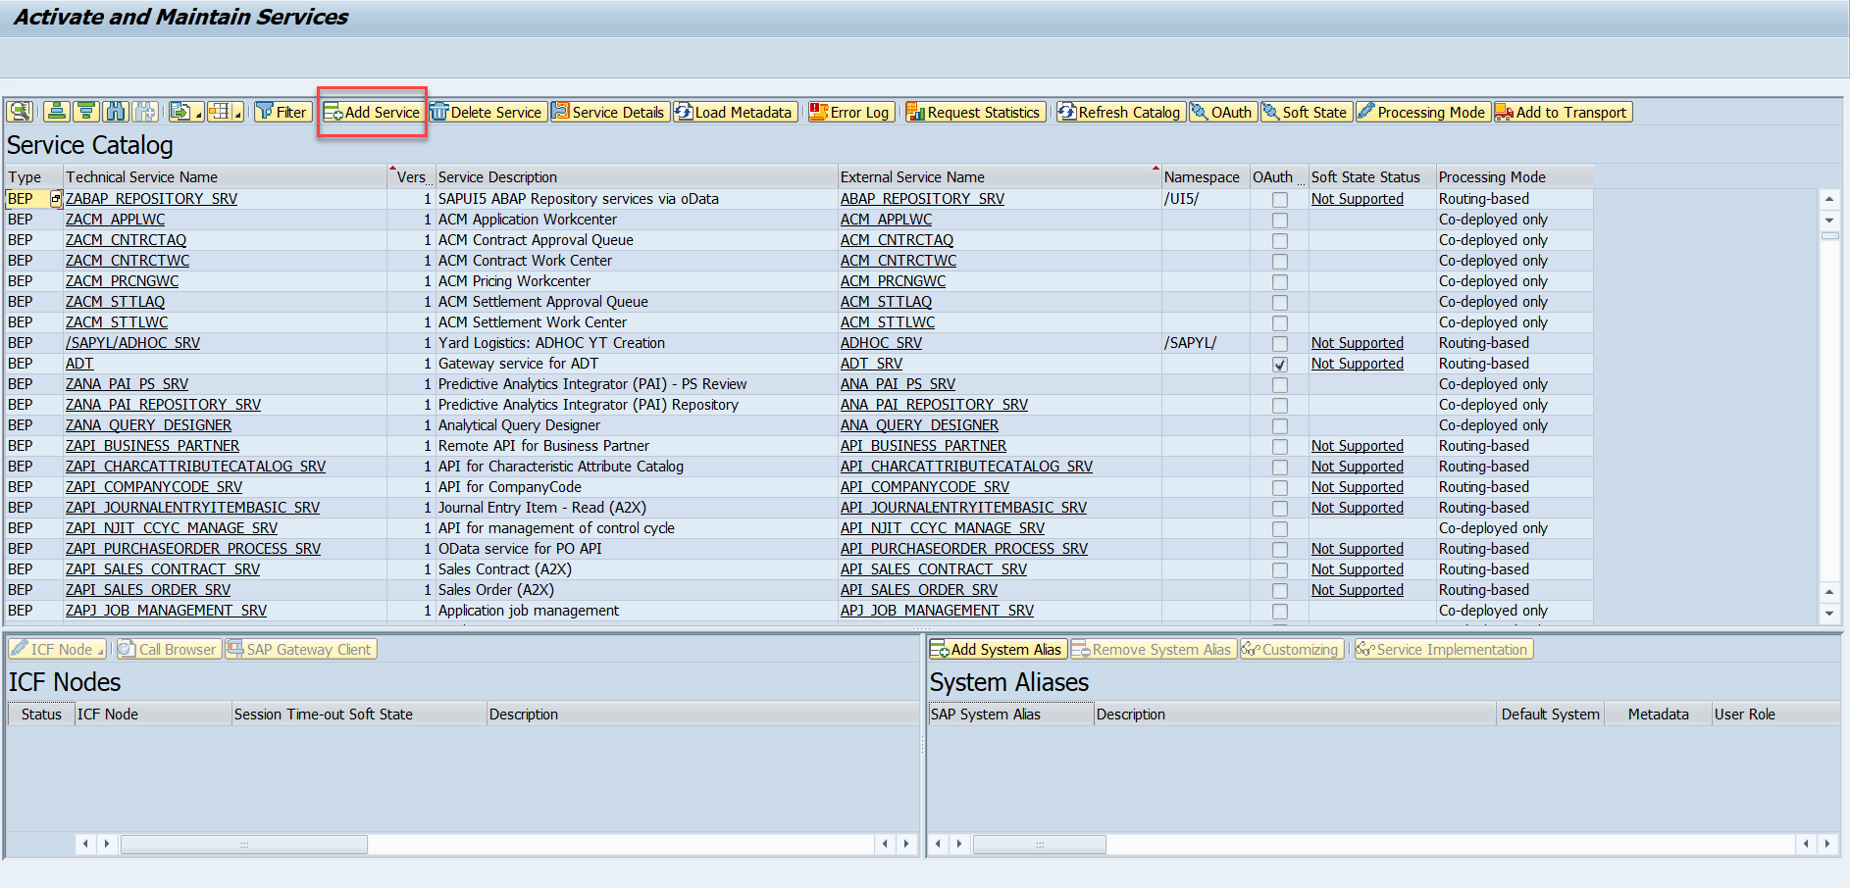
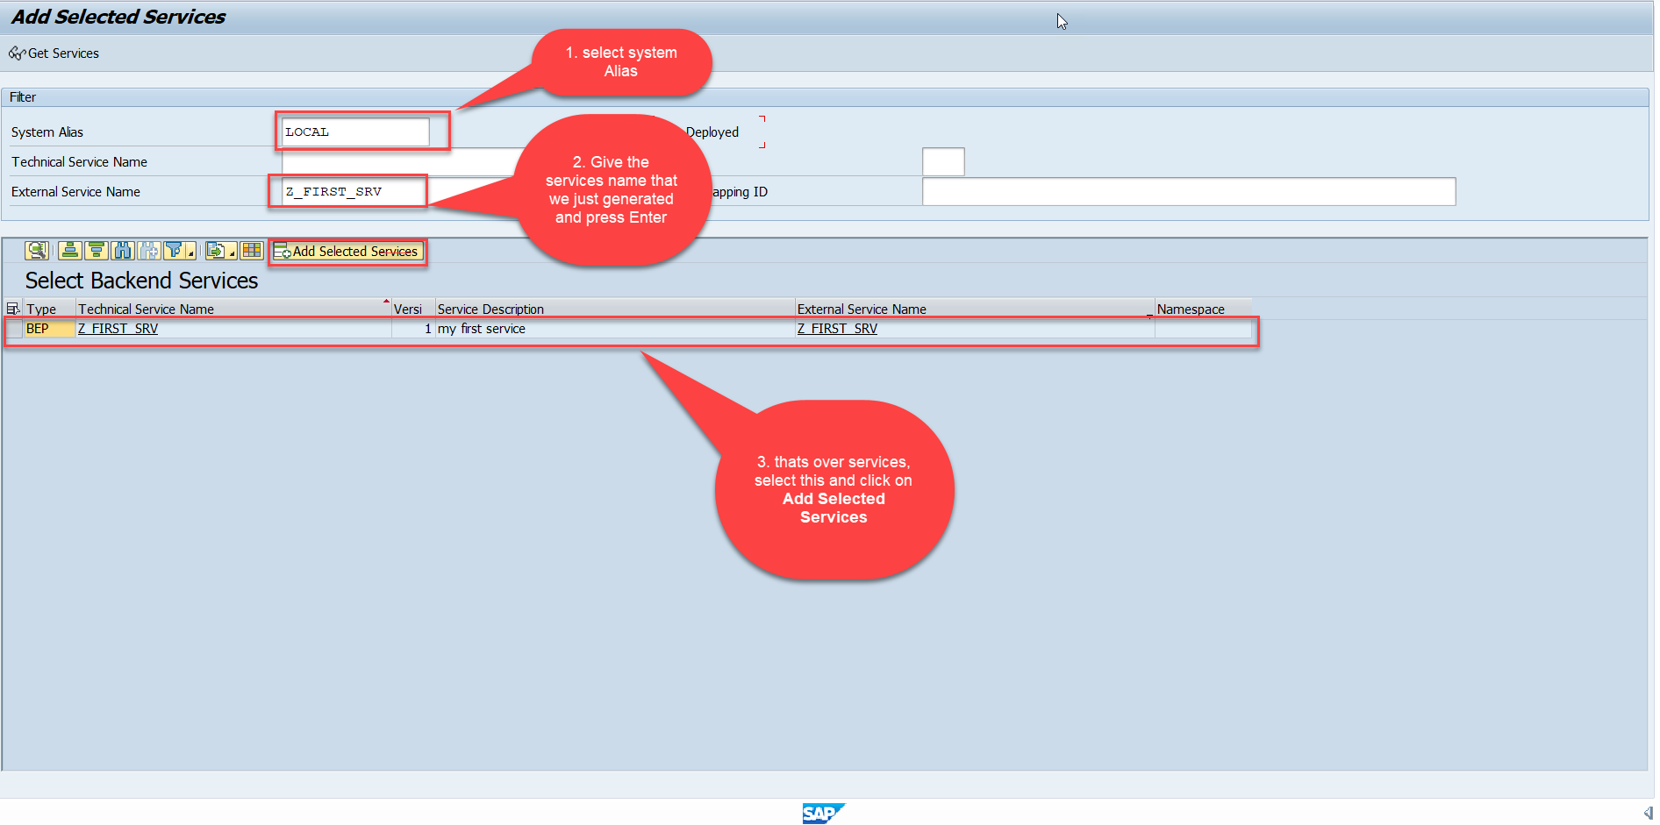
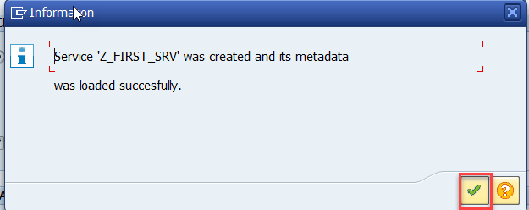
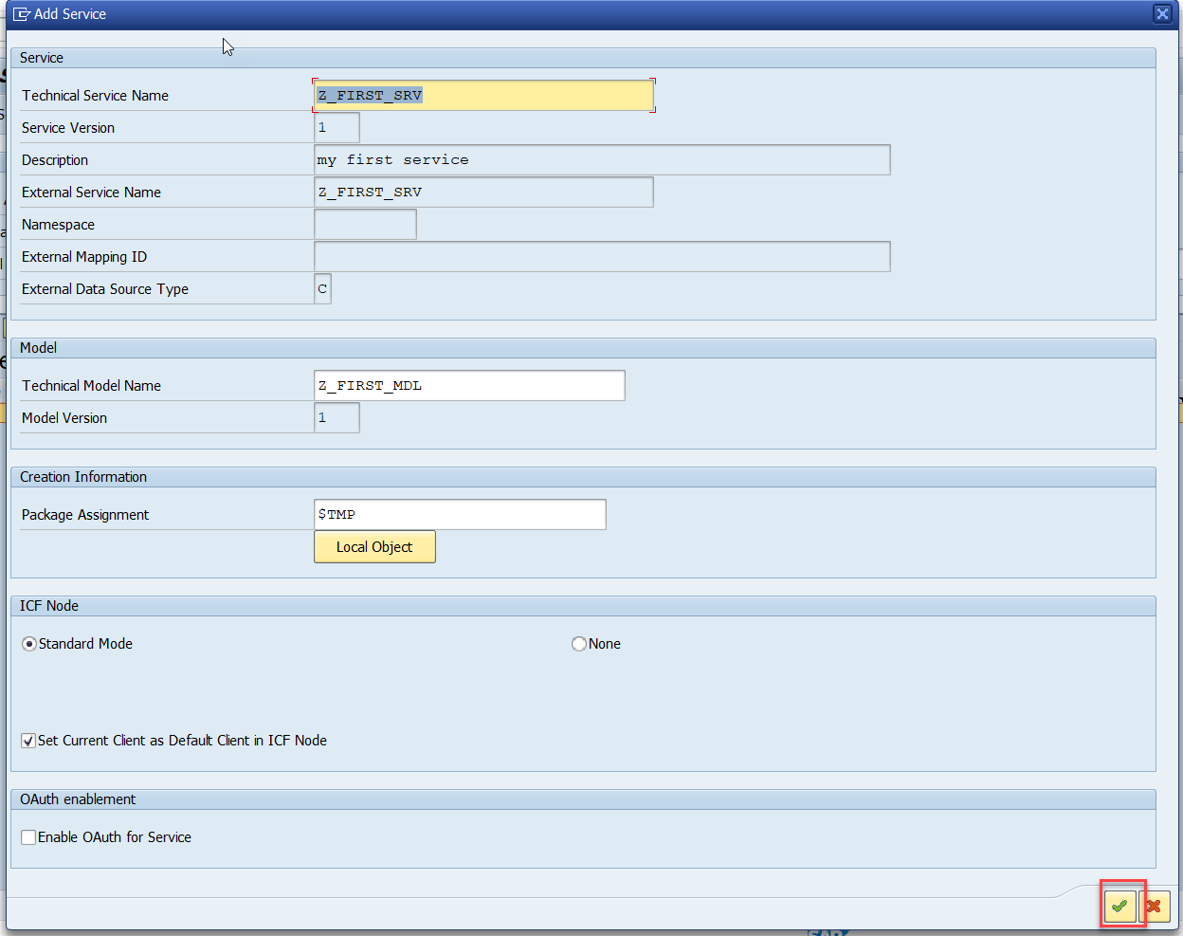
Creating OData Service Continue…
Step5: Service Registration (Go to tcode- /iwfnd/maint_service)

Slide 9
Runtime Artifacts
When we create a service there are 2 types of code which developer/system needs
Metadata code – which serve metadata of the service, will be generated by system automatically every time we change the service a new code will generate overwriting old code by SAP. This code is generated in MPC – model provider class
MPC = Model Provider Class (metadata) = where all the abap code will be generated which will have the code for metadata
Service Code – which is required as service implementation for performing CURDQ functionality. This code will be written by developer in a class called DPC = Data provider class.
DPC = Data Provider Class (data operations CRUDQ) = Contains all the implementation of CURDQ. It will get for each entityset 5 methods.
What if a developer need to customize the SAP generated code
SAP
Model provider class MPC class
Data Provider class
DPC class
Metadata
Types of entities
PROJ_SRV
Each entity 5 methods will be created –
OBJECT_GET_ENTITYSET
OBJECT_GET_ENTITY
OBJECT_CREATE_ENTITY
OBJECT_UPDATE_ENTITY
OBJECT_DELETE_ENTITY
MPC_EXT
Here we should write our code
DPC_EXT
CURD Functionality

Slide 10
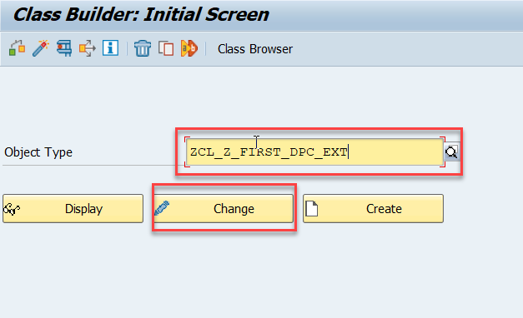
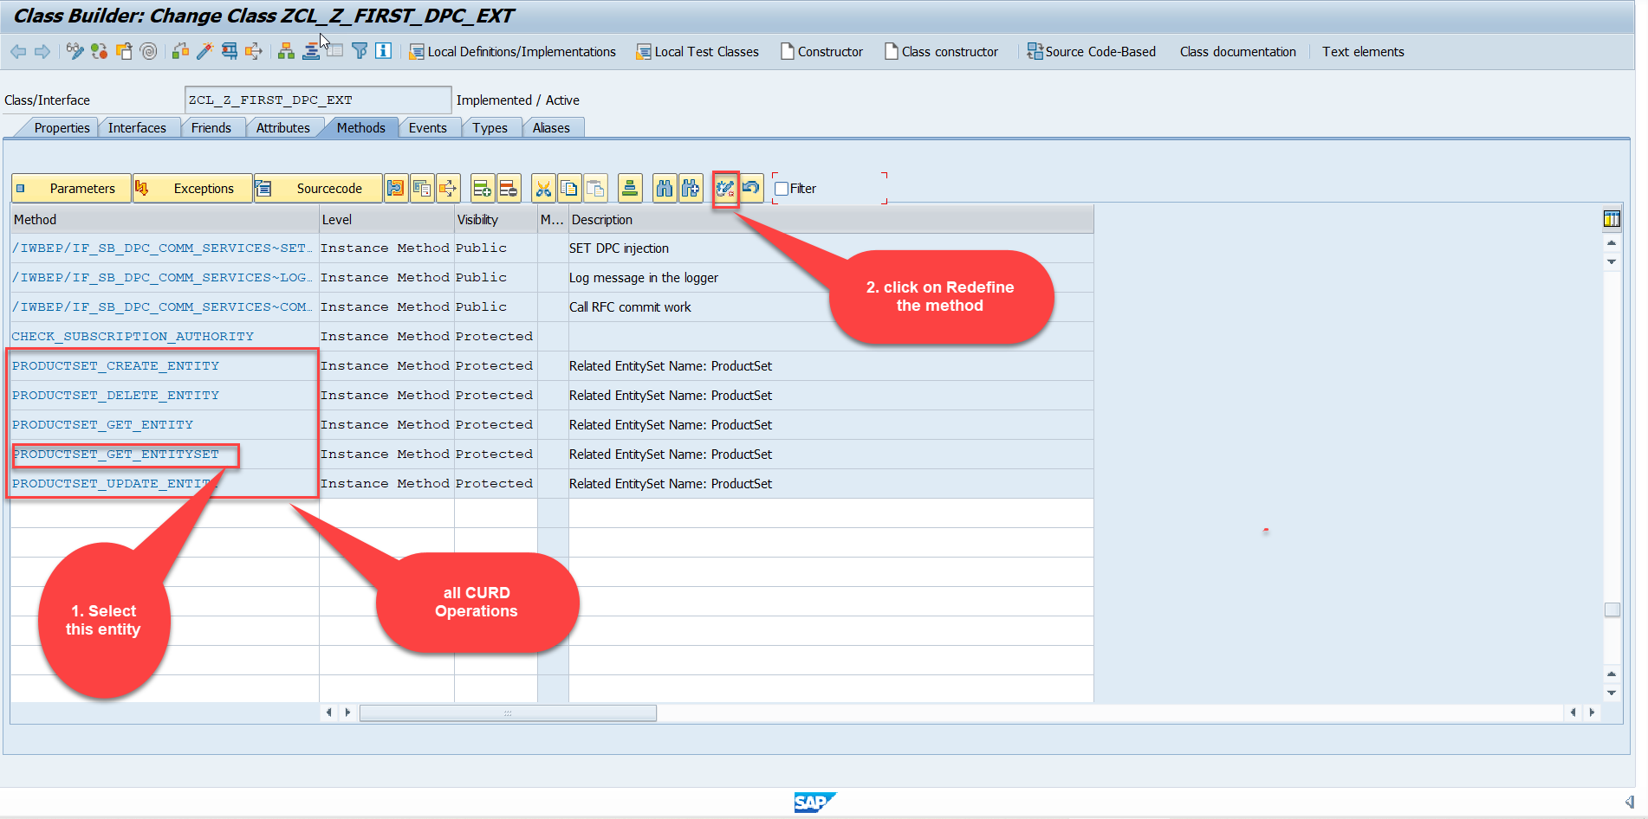
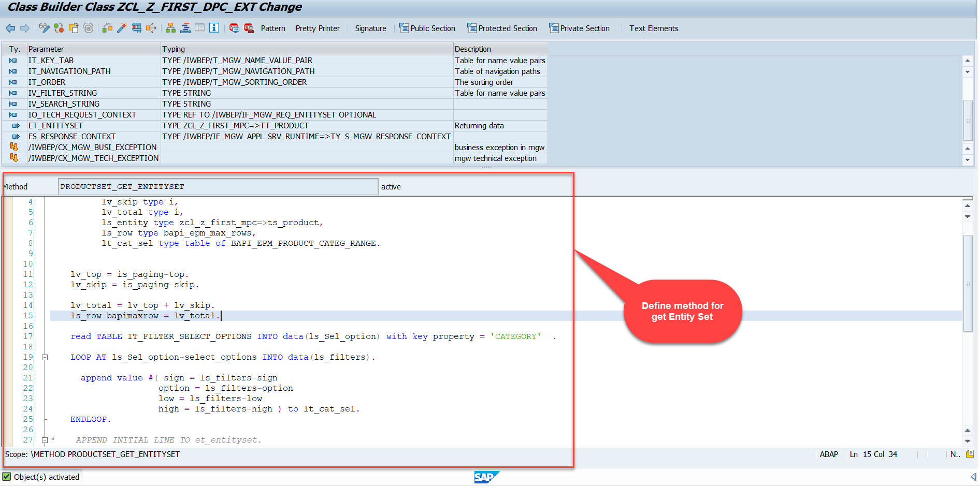
Building GetEntitySet Method
Step1: ProductSet Get Entity method(with filter, top and skip) in DPC Extension (Class Builder tcode- se24)
Code:
GetEntitySet

Slide 11
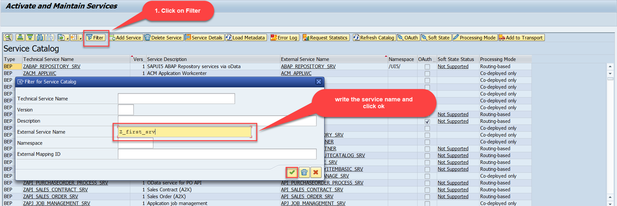
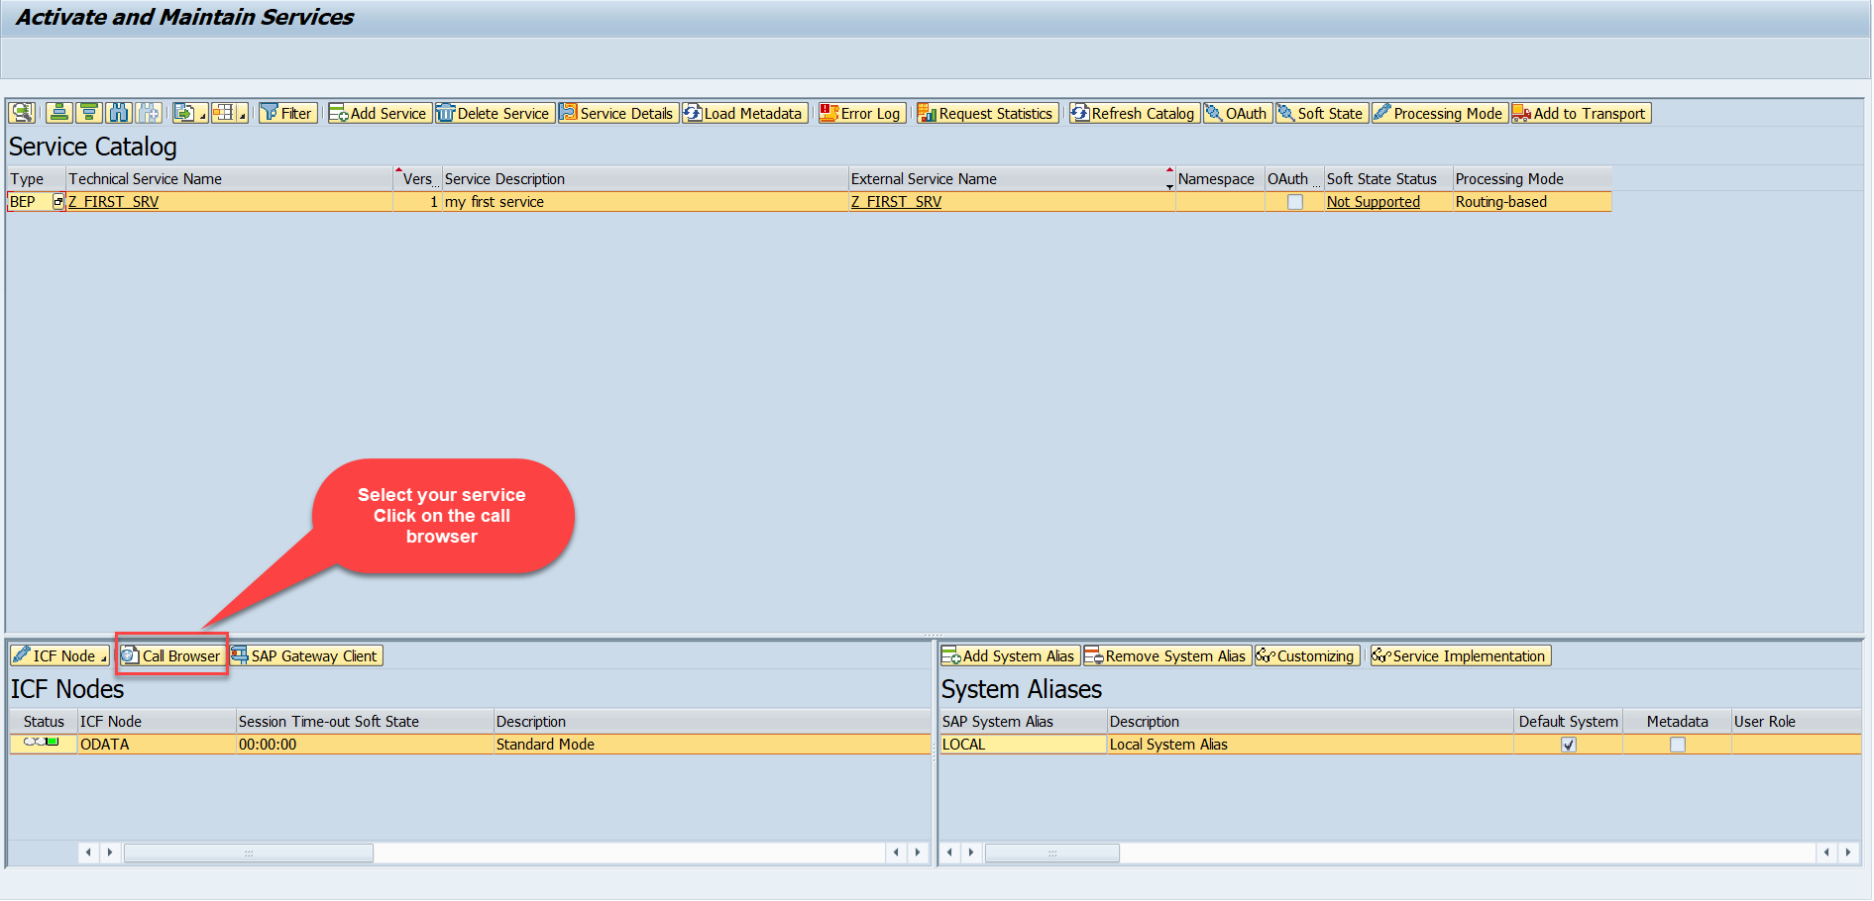
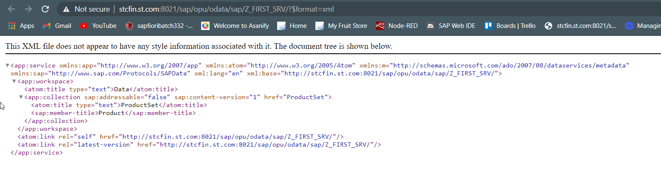
Building GetEntitySet Method Continue...
Step2: Call the service to the browser that we just created (go to service maintain (/iwfnd/maint_service))
Service in Browser

Slide 12
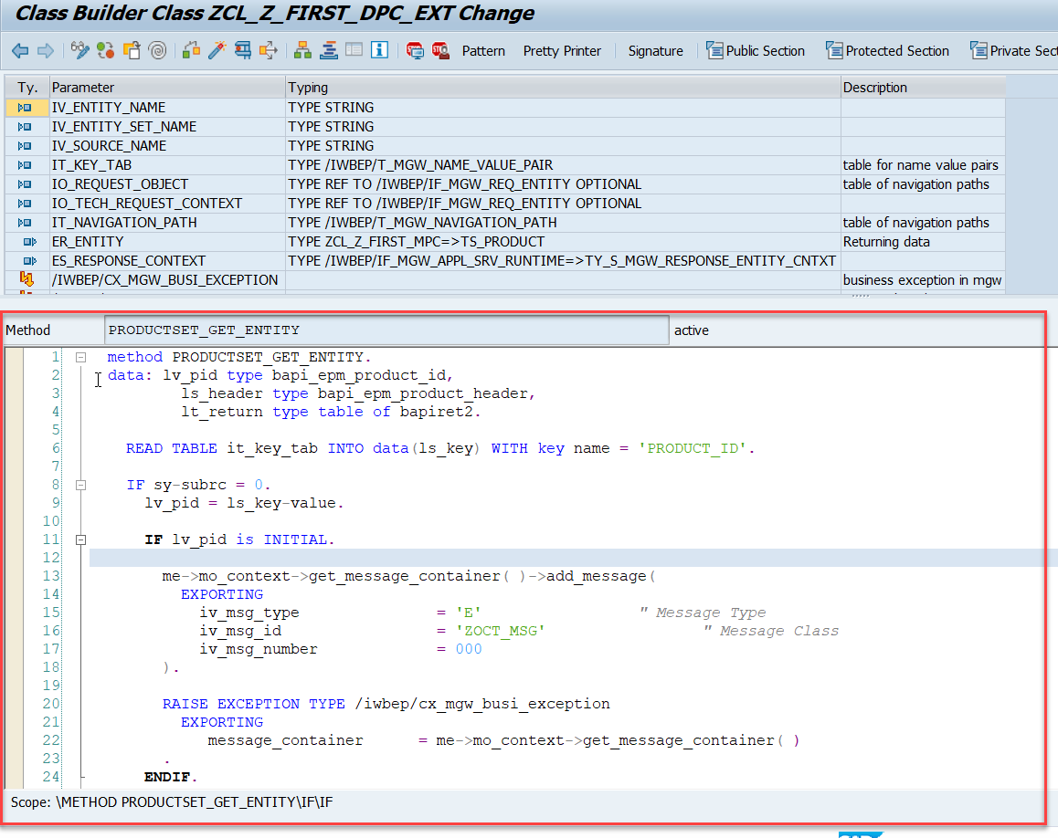
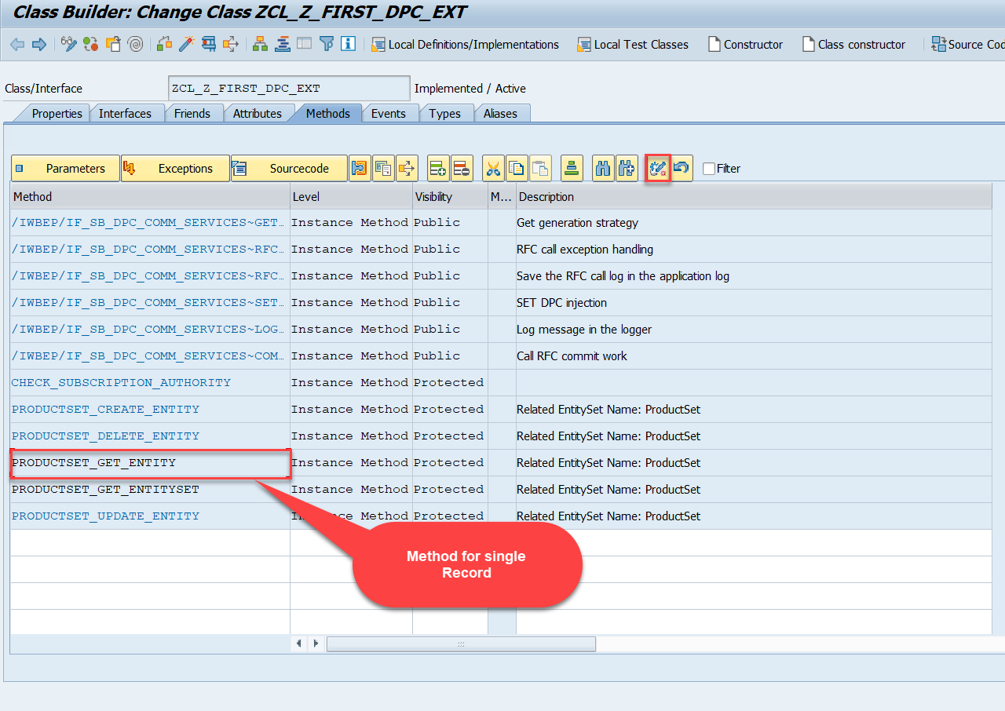
Building GetEntitySet Method Continue...
Go to DPC Extension of over service and redefine the method PRODUCTSET_GET_ENTITY
Code:
GetEntity

Slide 13
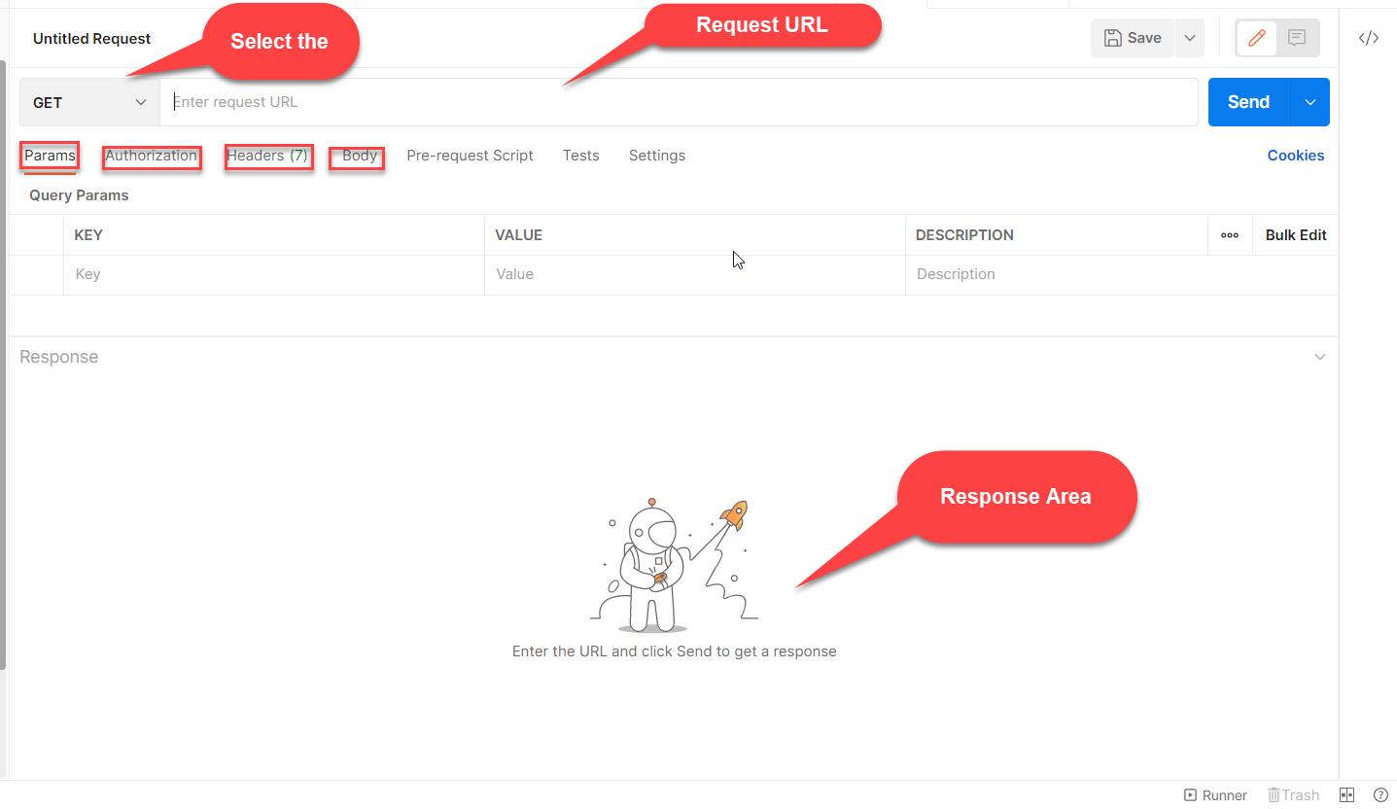

Postman
Postman is a free tool which can be used to test any kind of REST/OData Services outside of the system. This allows us to consume the data as if an external consumer would really do.
Postman is an API platform for building and using APIs. Postman simplifies each step of the API lifecycle and streamlines collaboration so you can create better APIs—faster.
As an ABAP developer, you can develop postman collection and deliver it to Fiori Developers for consumption to showcase, what our service is capable of.

Slide 14

End of Day 12

Slide 15

Questions

Slide 16

Anubhav Oberoy

Slide 17


We’re committed to empower you to be
Most Desirable Resource
through powerful training solutions.
We build the workforce of the future.
250+
Corporate Clients
30,000+
Learners Trained
25000+
Learners Placed
FREE WEBINARS
Sign up for free webinars with industry experts every fortnight!
Enroll Now!
Contact us today!
https://anubhavtrainings.com/

Slide 18




More from AnubhavTrainings.com

Slide 19
Title
Content

